Slide 1
Foundations of Cryptography Diffie-Hellman key exchange, man-in-the-middle attack, public-key encryption, IND-EAV, IND-CPA, IND-CCA, ElGamal encryption
LiangFeng Zhang
zhanglf@shanghaitech.edu.cn
SIST, ShanghaiTech, 2019F

Slide 2
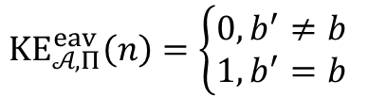
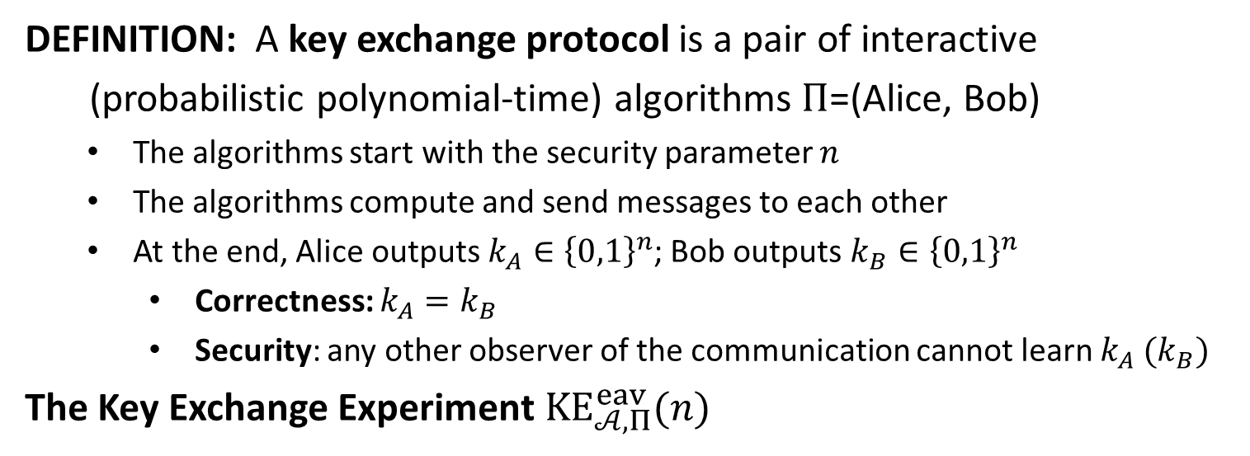



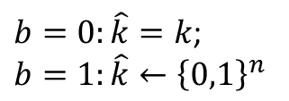


Key Exchange
DEFINITION: A key exchange protocol is a pair of interactive
(probabilistic polynomial-time) algorithms $Π$=(Alice, Bob)
The algorithms start with the security parameter $n$
The algorithms compute and send messages to each other
At the end, Alice outputs $k_{A}∈{\left\{0,1\right\}}^{n}$; Bob outputs $k_{B}∈{\left\{0,1\right\}}^{n}$
Correctness: $k_{A}=k_{B}$
Security: any other observer of the communication cannot learn $k_{A} (k_{B})$
The Key Exchange Experiment $KE_{𝒜,Π}^{eav}(n)$
$$\left(trans, k\right)←Π(n)$$
$$b←\{0,1\}$$
$b=0:\hat{k}=k$;
$$b=1:\hat{k}←{\left\{0,1\right\}}^{n}$$
$$(trans,\hat{k})$$
$$b′$$
$KE_{𝒜,Π}^{eav}\left(n\right)=\left\{\begin{aligned}0, b^{′}≠b \\ 1, b^{′}=b\end{aligned}\right.$
challenger
$$𝒜$$

Slide 3
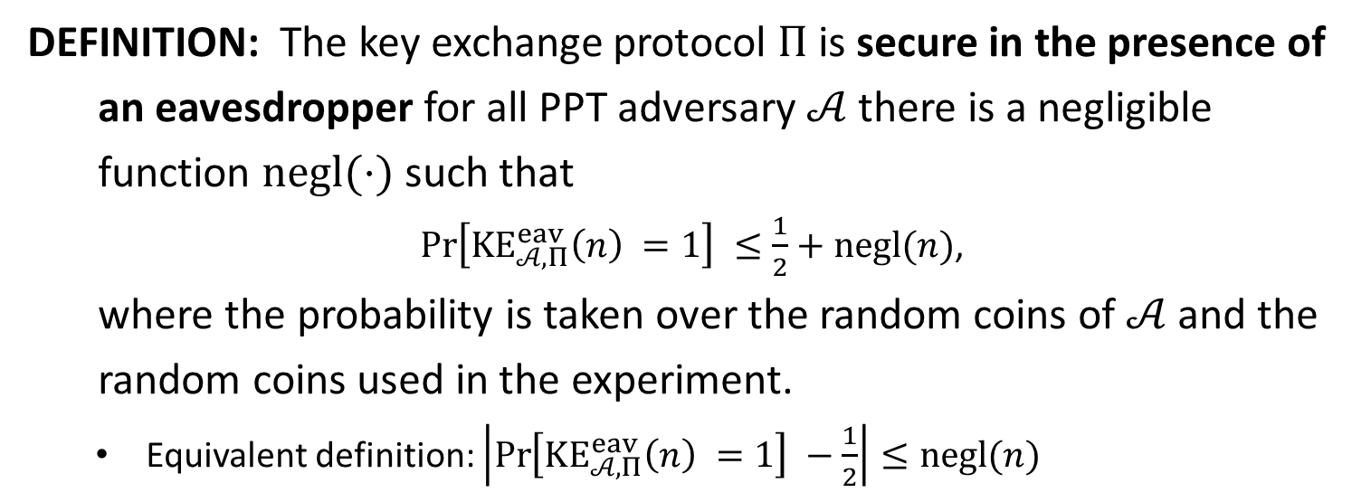
Security
DEFINITION: The key exchange protocol $Π$is secure in the presence of
an eavesdropper for all PPT adversary $𝒜$ there is a negligible
function $negl(⋅)$ such that
$\operatorname{Pr}\left[KE_{𝒜,Π}^{eav}\left(n\right) =1\right] ≤\frac{1}{2}+negl(n)$,
where the probability is taken over the random coins of $𝒜$ and the
random coins used in the experiment.
Equivalent definition: $\left|\operatorname{Pr}\left[KE_{𝒜,Π}^{eav}\left(n\right) =1\right] −\frac{1}{2}\right|≤negl(n)$

Slide 4

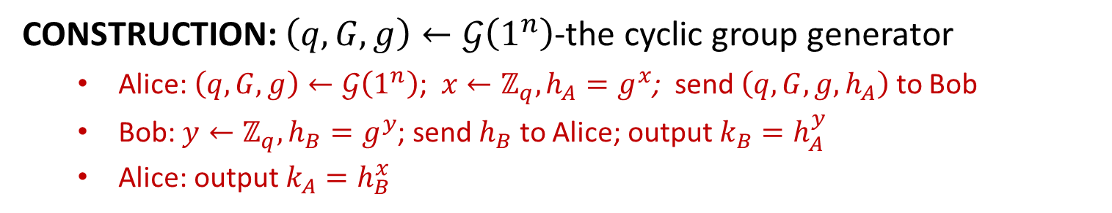

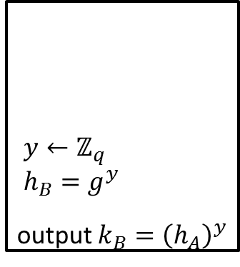
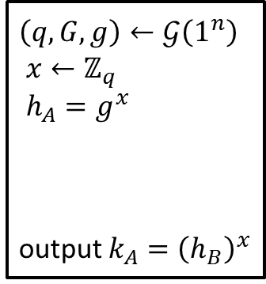
Diffie-Hellman Key Exchange
CONSTRUCTION: $\left(q,G,g\right)←𝒢\left(1^{n}\right)$-the cyclic group generator
Alice: $\left(q,G,g\right)←𝒢\left(1^{n}\right)$; $x←ℤ_{q}, h_{A}=g^{x}$; send $\left(q,G,g,h_{A}\right)$ to Bob
Bob: $y←ℤ_{q}, h_{B}=g^{y}$; send $h_{B}$ to Alice; output $k_{B}=h_{A}^{y}$
Alice: output $k_{A}=h_{B}^{x}$
$\left(q,G,g\right)←𝒢\left(1^{n}\right)$
$x←ℤ_{q}$
$h_{A}=g^{x}$
output $k_{A}={\left(h_{B}\right)}^{x}$
$y←ℤ_{q}$
$h_{B}=g^{y}$
output $k_{B}={\left(h_{A}\right)}^{y}$
$$(q,G,g,h_{A})$$
$$h_{B}$$
Alice
Bob
Correctness: $h_{A}^{y}=g^{xy}=h_{B}^{x}⇒k_{A}=k_{B}$ (A, B output the same key)

Slide 5
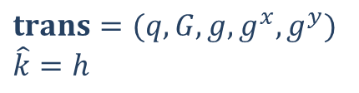
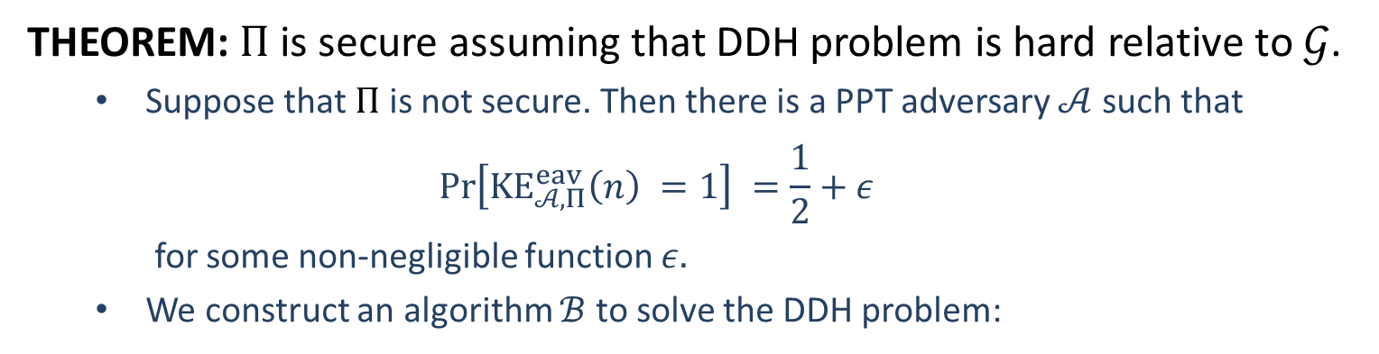

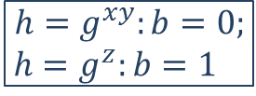






Security
THEOREM: $Π$ is secure assuming that DDH problem is hard relative to $𝒢$.
Suppose that $Π$ is not secure. Then there is a PPT adversary $𝒜$ such that
$$\operatorname{Pr}\left[KE_{𝒜,Π}^{eav}\left(n\right) =1\right] =\frac{1}{2}+ε$$
for some non-negligible function $ε.$
We construct an algorithm $ℬ$ to solve the DDH problem:
$$t=(q,G,g,g^{x},g^{y},h)$$
$h=g^{xy}$ or $h=g^{z}$
$$trans=(q,G,g,g^{x}, g^{y})$$
$$\hat{k}=h$$
$$(trans,\hat{k})$$
$$b^{′}$$
$$b′$$
$$ℬ$$
$$𝒜$$
$$h=g^{xy}:b=0;$$
$h=g^{z}:b=1$

Slide 6
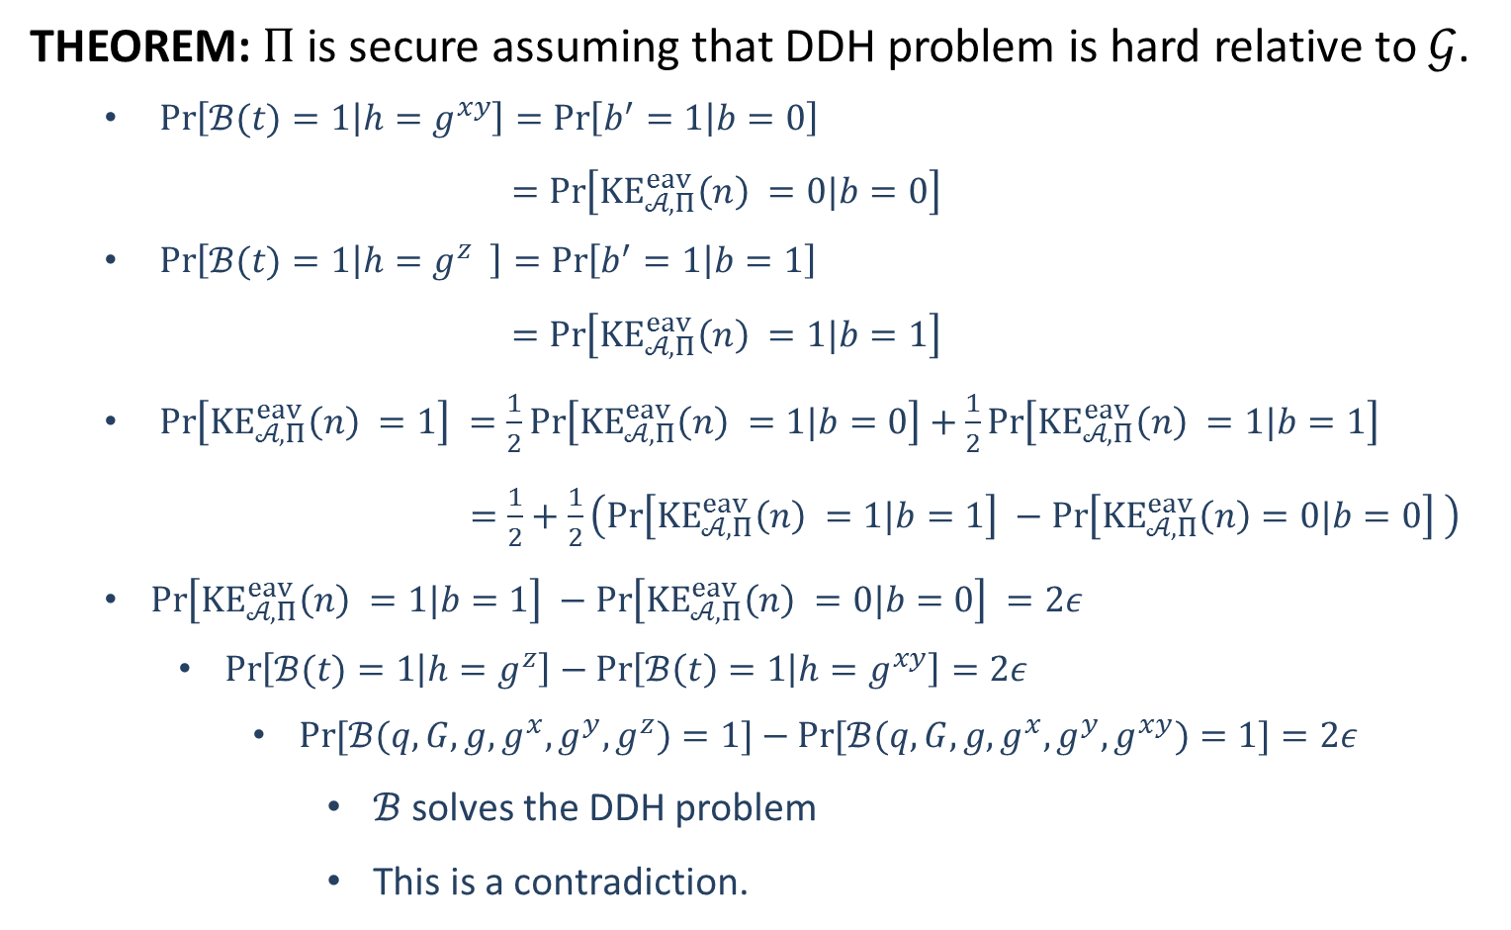
Security
THEOREM: $Π$ is secure assuming that DDH problem is hard relative to $𝒢$.
$\operatorname{Pr}\left[ℬ(t)=1 | h=g^{xy}\right]=\operatorname{Pr}\left[b^{′}=1 | b=0\right]$
$=\operatorname{Pr}\left[KE_{𝒜,Π}^{eav}\left(n\right) =0|b=0\right]$
$\operatorname{Pr}\left[ℬ(t)=1 | h=g^{z} \right]=\operatorname{Pr}\left[b^{′}=1 | b=1\right]$
$=\operatorname{Pr}\left[KE_{𝒜,Π}^{eav}\left(n\right) =1|b=1\right]$
$\operatorname{Pr}\left[KE_{𝒜,Π}^{eav}\left(n\right) =1\right] =\frac{1}{2}\operatorname{Pr}\left[KE_{𝒜,Π}^{eav}\left(n\right) =1|b=0\right]+\frac{1}{2}\operatorname{Pr}\left[KE_{𝒜,Π}^{eav}\left(n\right) =1|b=1\right]$
$=\frac{1}{2}+\frac{1}{2}\left(\operatorname{Pr}\left[KE_{𝒜,Π}^{eav}\left(n\right) =1|b=1\right] −\operatorname{Pr}\left[KE_{𝒜,Π}^{eav}\left(n\right)=0|b=0\right] \right)$
$\operatorname{Pr}\left[KE_{𝒜,Π}^{eav}\left(n\right) =1|b=1\right] −\operatorname{Pr}\left[KE_{𝒜,Π}^{eav}\left(n\right) =0|b=0\right] =2ε$
$\operatorname{Pr}\left[ℬ(t)=1 | h=g^{z}\right]−\operatorname{Pr}\left[ℬ\left(t\right)=1 | h=g^{xy}\right]=2ε$
$\operatorname{Pr}{[ℬ(q,G,g,g^{x},g^{y},g^{z})=1]}−\operatorname{Pr}{[ℬ(q,G,g,g^{x},g^{y},g^{xy})=1]}=2ε$
$ℬ$ solves the DDH problem
This is a contradiction.

Slide 7

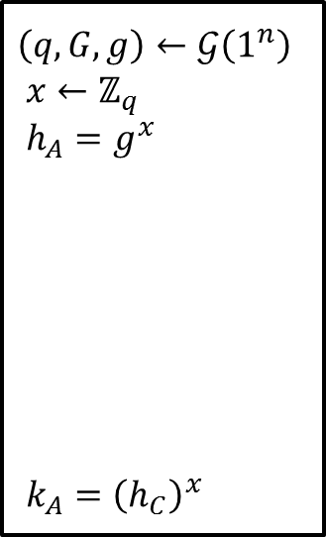



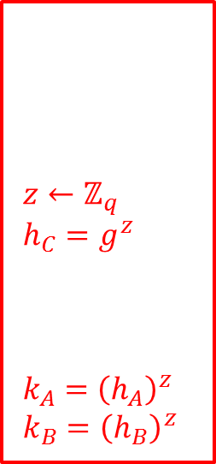

Man-in-the-middle attack
Diffie-Hellman key exchange requires an authenticated channel:
Modification to the communication should be detectable.
Otherwise, there is a man-in-the-middle attack.
Man-in-the-middle attack: A and B output different keys (known to C)
$\left(q,G,g\right)←𝒢\left(1^{n}\right)$
$x←ℤ_{q}$
$h_{A}=g^{x}$
${k_{A}=\left(h_{C}\right)}^{x}$
$z←ℤ_{q}$
$h_{C}=g^{z}$
$k_{A}={\left(h_{A}\right)}^{z}$
$k_{B}={\left(h_{B}\right)}^{z}$
$y←ℤ_{q}$
$h_{B}=g^{y}$
${k_{B}=\left(h_{C}\right)}^{y}$
$$q,G,g,h_{A}$$
$$q,G,g,h_{C}$$
$$h_{B}$$
$$h_{C}$$
Alice
Charlie
Bob

Slide 9





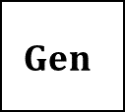

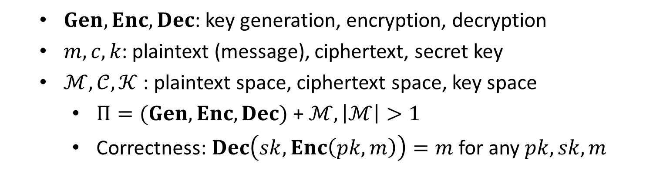



Public-Key Encryption
$$m$$
$$Enc$$
$$c←Enc(pk, m)$$
$$Dec$$
Alice
Bob
$$pk$$
$$sk$$
$$Dec(sk, c)=m$$
$$Gen$$
$Gen, Enc, Dec$: key generation, encryption, decryption
$m, c, k$: plaintext (message), ciphertext, secret key
$ℳ,𝒞, 𝒦$ : plaintext space, ciphertext space, key space
$Π=(Gen, Enc, Dec)$ + $ℳ, \left|ℳ\right|>1$
Correctness: $Dec\left(sk,Enc\left(pk,m\right)\right)=m$ for any $pk,sk,m$

Slide 10
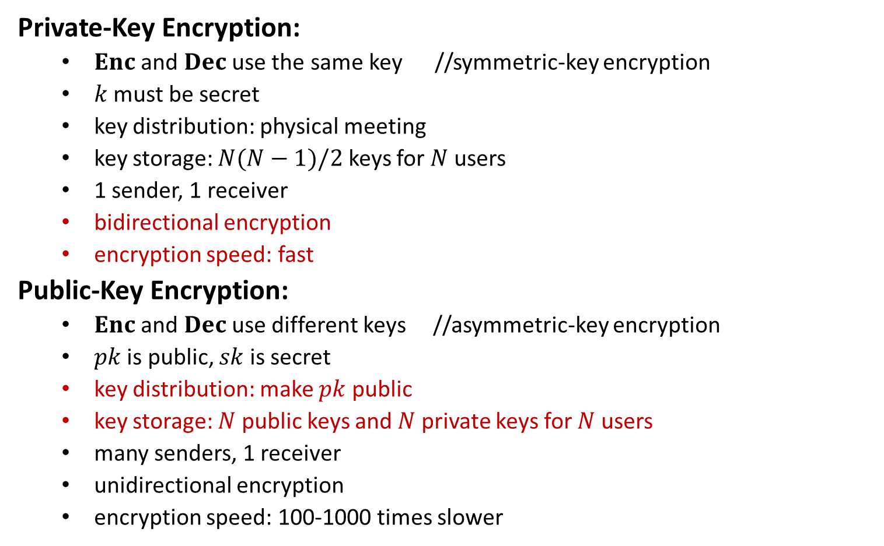
Comparisons
Private-Key Encryption:
$Enc$ and $Dec$ use the same key //symmetric-key encryption
$k$ must be secret
key distribution: physical meeting
key storage: $N(N−1)/2$ keys for $N$ users
1 sender, 1 receiver
bidirectional encryption
encryption speed: fast
Public-Key Encryption:
$Enc$ and $Dec$ use different keys //asymmetric-key encryption
$pk$ is public, $sk$ is secret
key distribution: make $pk$ public
key storage: $N$ public keys and $N$ private keys for $N$ users
many senders, 1 receiver
unidirectional encryption
encryption speed: 100-1000 times slower

Slide 12


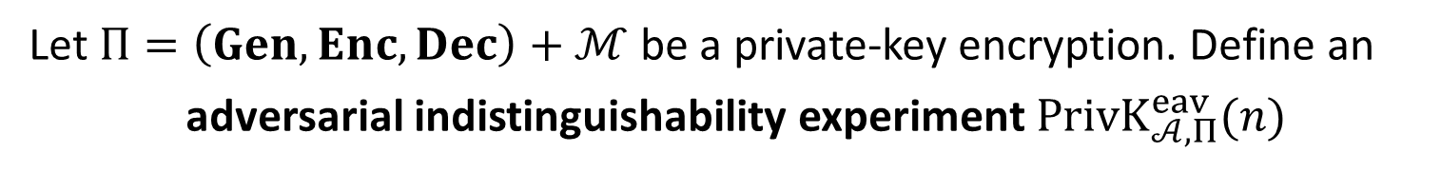



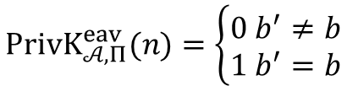


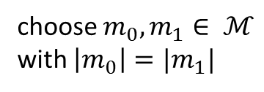

IND-EAV (PriKE)
Let $Π=\left(Gen, Enc, Dec\right)+ℳ$ be a private-key encryption. Define an
adversarial indistinguishability experiment $PrivK_{𝒜, Π}^{eav}(n)$
choose $m_{0}, m_{1}∈ ℳ$
with $\left|m_{0}\right|=|m_{1}|$
$$m_{0},m_{1}$$
$$k←Gen\left(1^{n}\right)$$
$$b←\{0,1\}$$
$$Challenger$$
$$c←Enc(k,m_{b})$$
$$Adversary 𝒜$$
$$c$$
$$b′$$
$$PrivK_{𝒜, Π}^{eav}(n)=\left\{\begin{aligned}0 b^{′}≠b \\ 1 b^{′}=b\end{aligned}\right.$$

Slide 13

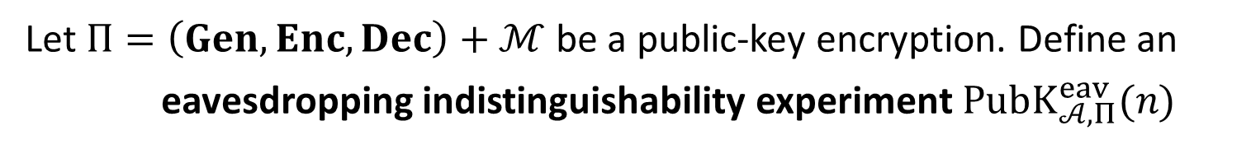


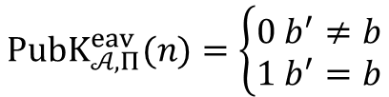

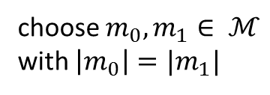

IND-EAV (PubKE)
Let $Π=\left(Gen, Enc, Dec\right)+ℳ$ be a public-key encryption. Define an
eavesdropping indistinguishability experiment $PubK_{𝒜, Π}^{eav}(n)$
$$(pk,sk)←Gen\left(1^{n}\right)$$
$$pk$$
choose $m_{0}, m_{1}∈ ℳ$
with $\left|m_{0}\right|=|m_{1}|$
$$m_{0},m_{1}$$
$$b←\{0,1\}$$
$$Challenger$$
$$c←Enc(pk,m_{b})$$
$$Adversary 𝒜$$
$$c$$
$$b′$$
$$PubK_{𝒜, Π}^{eav}(n)=\left\{\begin{aligned}0 b^{′}≠b \\ 1 b^{′}=b\end{aligned}\right.$$

Slide 14
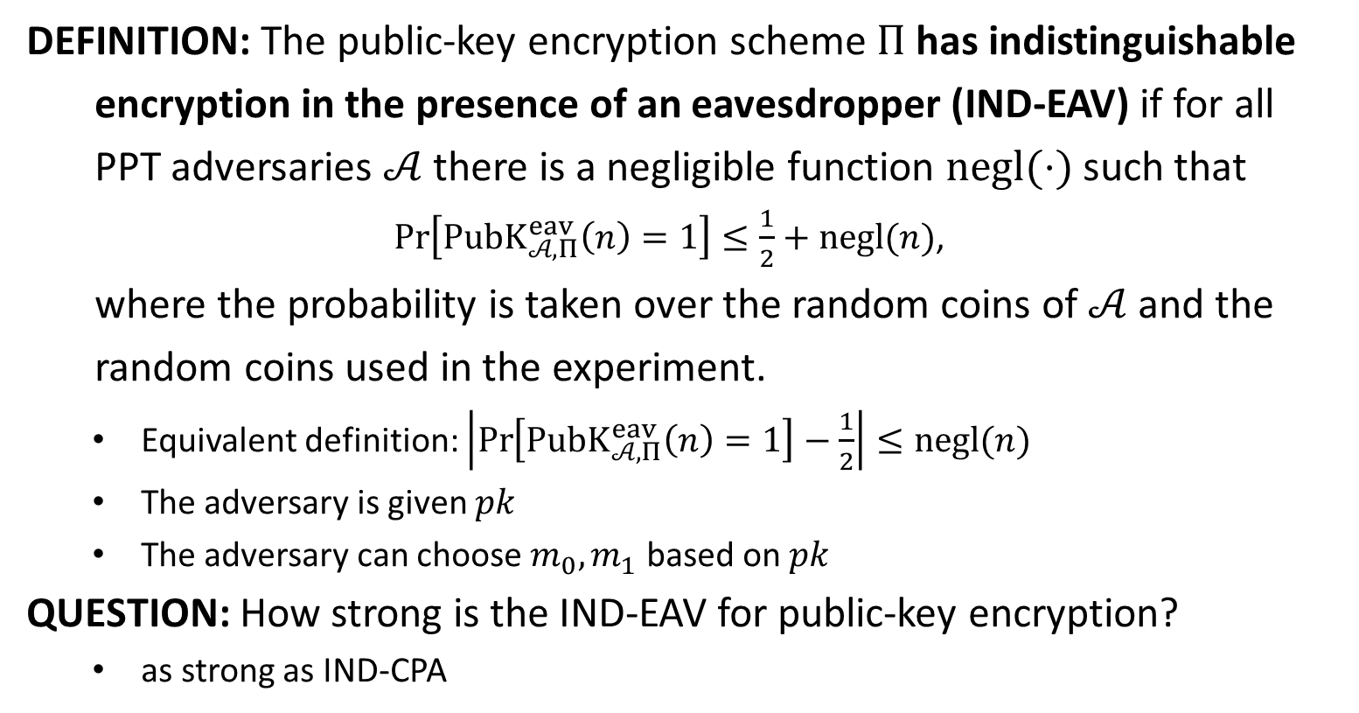
IND-EAV
DEFINITION: The public-key encryption scheme $Π$ has indistinguishable
encryption in the presence of an eavesdropper (IND-EAV) if for all
PPT adversaries $𝒜$ there is a negligible function $negl(⋅)$ such that
$\operatorname{Pr}\left[PubK_{𝒜, Π}^{eav}\left(n\right)=1\right]≤\frac{1}{2}+negl(n)$,
where the probability is taken over the random coins of $𝒜$ and the
random coins used in the experiment.
Equivalent definition: $\left|\operatorname{Pr}\left[PubK_{𝒜, Π}^{eav}\left(n\right)=1\right]−\frac{1}{2}\right|≤negl(n)$
The adversary is given $pk$
The adversary can choose $m_{0},m_{1}$ based on $pk$
QUESTION: How strong is the IND-EAV for public-key encryption?
as strong as IND-CPA

Slide 15


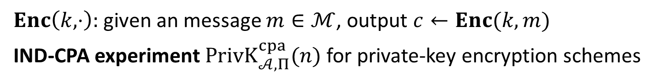










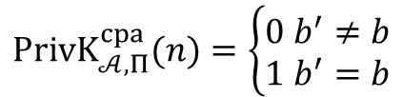

IND-CPA (PrivKE)
$Enc\left(k,⋅\right):$given an message $m∈ℳ$, output $c←Enc(k,m)$
IND-CPA experiment $PrivK_{𝒜, Π}^{cpa}(n)$ for private-key encryption schemes
$$k←Gen\left(1^{n}\right)$$
$$orace access to$$
$$Enc\left(k,⋅\right)$$
$$m_{0},m_{1}$$
$$\left|m_{0}\right|=|m_{1}|$$
$$Challenger$$
$$b←\{0,1\}$$
$$Adversary 𝒜$$
$$c←Enc(k,m_{b})$$
$$c$$
$$orace access to$$
$$Enc\left(k,⋅\right)$$
$$b′$$
$$PrivK_{𝒜, Π}^{cpa}(n)=\left\{\begin{aligned}0 b^{′}≠b \\ 1 b^{′}=b\end{aligned}\right.$$

Slide 16












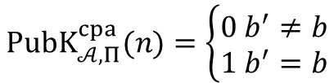

IND-CPA (PubKE)
IND-CPA experiment $PubK_{𝒜, Π}^{cpa}(n)$ for public-key encryption schemes
$$(pk,sk)←Gen\left(1^{n}\right)$$
$$pk$$
$$orace access to$$
$$Enc\left(pk,⋅\right)$$
$$m_{0},m_{1}$$
$$Challenger$$
$$\left|m_{0}\right|=|m_{1}|$$
$$Adversary 𝒜$$
$$b←\{0,1\}$$
$$c←Enc(pk,m_{b})$$
$$c$$
$$orace access to$$
$$Enc\left(pk,⋅\right)$$
$$b′$$
$$PubK_{𝒜, Π}^{cpa}(n)=\left\{\begin{aligned}0 b^{′}≠b \\ 1 b^{′}=b\end{aligned}\right.$$

Slide 17
IND-CPA (PubKE)
IND-CPA experiment $PubK_{𝒜, Π}^{cpa}(n)$ for public-key encryption schemes
$$(pk,sk)←Gen\left(1^{n}\right)$$
$$pk$$
$$m_{0},m_{1}$$
$$Challenger$$
$$\left|m_{0}\right|=|m_{1}|$$
$$Adversary 𝒜$$
$$b←\{0,1\}$$
$$c←Enc(pk,m_{b})$$
$$c$$
$$b′$$
$$PubK_{𝒜, Π}^{cpa}(n)=\left\{\begin{aligned}0 b^{′}≠b \\ 1 b^{′}=b\end{aligned}\right.$$

Slide 18
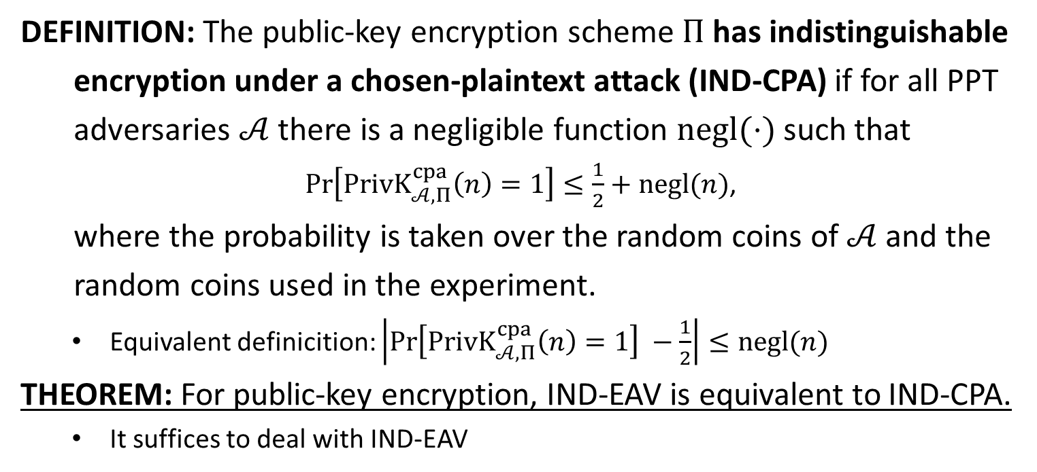
IND-CPA
DEFINITION: The public-key encryption scheme $Π$ has indistinguishable
encryption under a chosen-plaintext attack (IND-CPA) if for all PPT
adversaries $𝒜$ there is a negligible function $negl(⋅)$ such that
$\operatorname{Pr}\left[PrivK_{𝒜, Π}^{cpa}\left(n\right)=1\right]≤\frac{1}{2}+negl(n)$,
where the probability is taken over the random coins of $𝒜$ and the
random coins used in the experiment.
Equivalent definicition: $\left|\operatorname{Pr}\left[PrivK_{𝒜, Π}^{cpa}\left(n\right)=1\right] −\frac{1}{2}\right|≤negl(n)$
THEOREM: For public-key encryption, IND-EAV is equivalent to IND-CPA.
It suffices to deal with IND-EAV

Slide 19

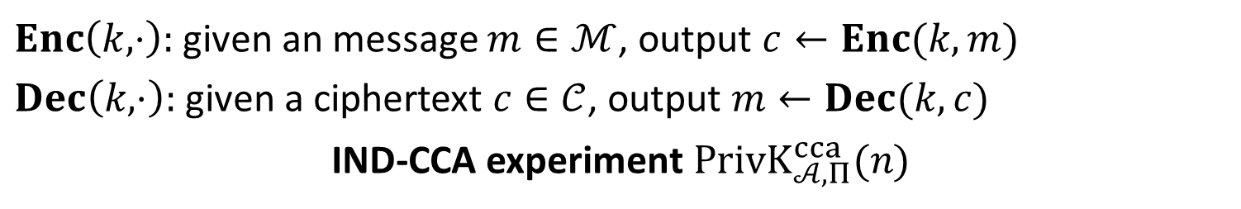









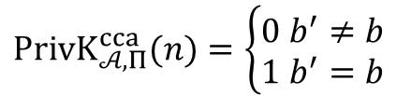

CCA (PrivKE)
$Enc\left(k,⋅\right):$given an message $m∈ℳ$, output $c←Enc(k,m)$
$Dec\left(k,⋅\right):$given a ciphertext $c∈𝒞$, output $m←Dec(k,c)$
IND-CCA experiment $PrivK_{𝒜, Π}^{cca}(n)$
$$k←Gen\left(1^{n}\right)$$
$$oracle access to$$
$$Enc\left(k,⋅\right), Dec(k,⋅)$$
$$m_{0},m_{1}$$
$$\left|m_{0}\right|=|m_{1}|$$
$$Challenger$$
$$b←\{0,1\}$$
$$Adversary 𝒜$$
$$c←Enc(k,m_{b})$$
$$c$$
$$oracle access to$$
$$Enc\left(k,⋅\right), Dec(k,⋅)$$
$$b′$$
$$PrivK_{𝒜, Π}^{cca}(n)=\left\{\begin{aligned}0 b^{′}≠b \\ 1 b^{′}=b\end{aligned}\right.$$

Slide 20



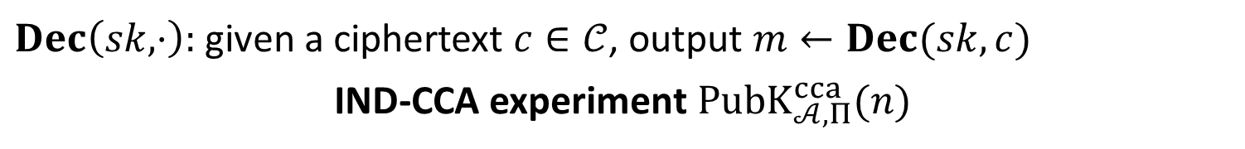









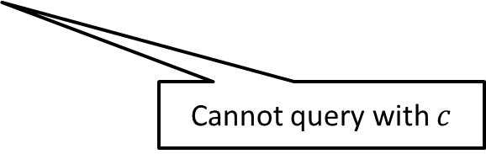

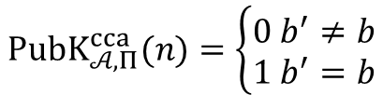

CCA (PubKE)
$Dec\left(sk,⋅\right):$given a ciphertext $c∈𝒞$, output $m←Dec(sk,c)$
IND-CCA experiment $PubK_{𝒜, Π}^{cca}(n)$
$$(pk,sk)←Gen\left(1^{n}\right)$$
$$pk$$
$$oracle access to$$
$$Dec(sk,⋅)$$
$$Challenger$$
$$m_{0},m_{1}$$
$$Adversary 𝒜$$
$$\left|m_{0}\right|=|m_{1}|$$
$$b←\{0,1\}$$
$$c←Enc(k,m_{b})$$
$$c$$
$$oracle access to$$
$$Dec(sk,⋅)$$
$$b′$$
$$PubK_{𝒜, Π}^{cca}(n)=\left\{\begin{aligned}0 b^{′}≠b \\ 1 b^{′}=b\end{aligned}\right.$$
Cannot query with $c$

Slide 21
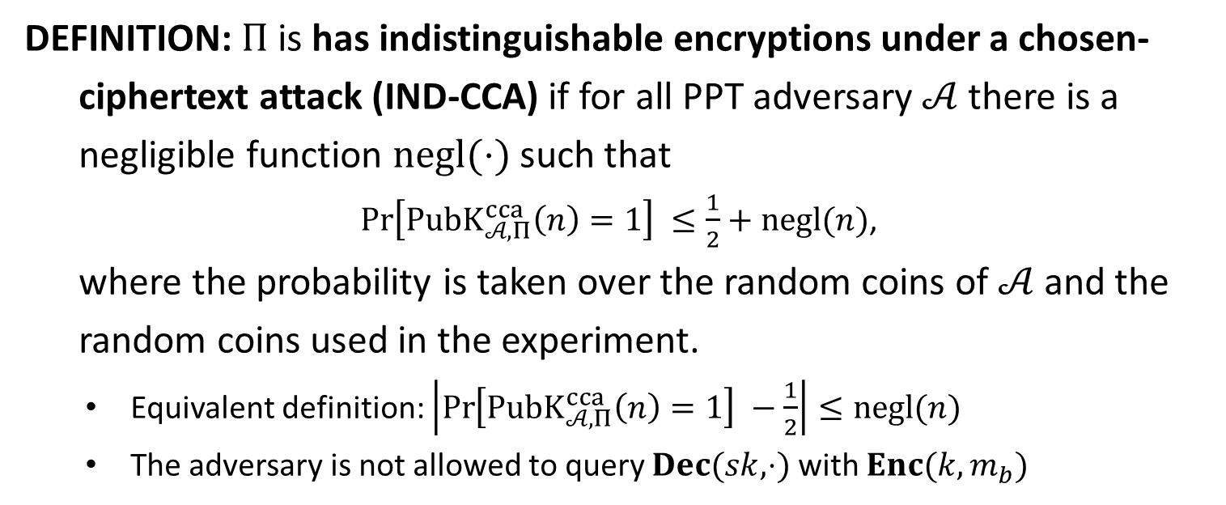
IND-CCA
DEFINITION: $Π$is has indistinguishable encryptions under a chosen-
ciphertext attack (IND-CCA) if for all PPT adversary $𝒜$ there is a
negligible function $negl(⋅)$ such that
$\operatorname{Pr}\left[PubK_{𝒜, Π}^{cca}\left(n\right)=1\right] ≤\frac{1}{2}+negl(n)$,
where the probability is taken over the random coins of $𝒜$ and the
random coins used in the experiment.
Equivalent definition: $\left|\operatorname{Pr}\left[PubK_{𝒜, Π}^{cca}\left(n\right)=1\right] −\frac{1}{2}\right|≤negl(n)$
The adversary is not allowed to query $Dec(sk,⋅)$ with $Enc(k,m_{b})$

Slide 23
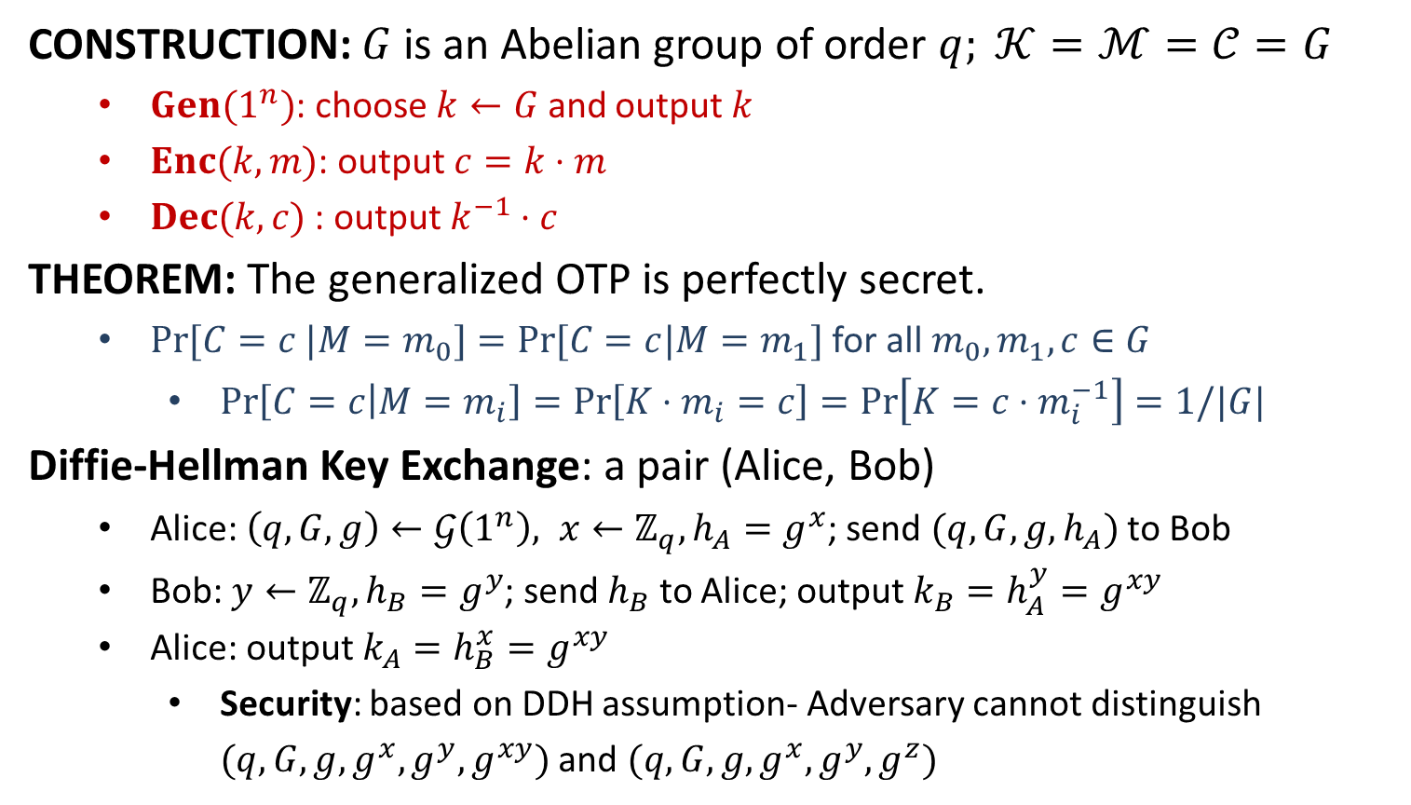
Generalized OTP
CONSTRUCTION: $G$ is an Abelian group of order $q; 𝒦=ℳ=𝒞=G$
$Gen(1^{n})$: choose $k←G$ and output $k$
$Enc(k,m)$: output $c=k⋅m$
$Dec(k,c)$ : output $k^{−1}⋅c$
THEOREM: The generalized OTP is perfectly secret.
$Pr⁡[C=c |M=m_{0}]=Pr⁡[C=c|M=m_{1}]$ for all $m_{0}, m_{1}, c∈G$
$\operatorname{Pr}\left[C=c | M=m_{i}\right]=\operatorname{Pr}\left[K⋅m_{i}=c\right]=\operatorname{Pr}\left[K=c⋅m_{i}^{−1}\right]=1/|G|$
Diffie-Hellman Key Exchange: a pair (Alice, Bob)
Alice: $\left(q,G,g\right)←𝒢\left(1^{n}\right), x←ℤ_{q}, h_{A}=g^{x}$; send $(q,G,g,h_{A})$ to Bob
Bob: $y←ℤ_{q}, h_{B}=g^{y}$; send $h_{B}$ to Alice; output $k_{B}=h_{A}^{y}=g^{xy}$
Alice: output $k_{A}=h_{B}^{x}=g^{xy}$
Security: based on DDH assumption- Adversary cannot distinguish $(q,G,g,g^{x},g^{y},g^{xy})$ and $(q,G,g,g^{x},g^{y},g^{z})$

Slide 24
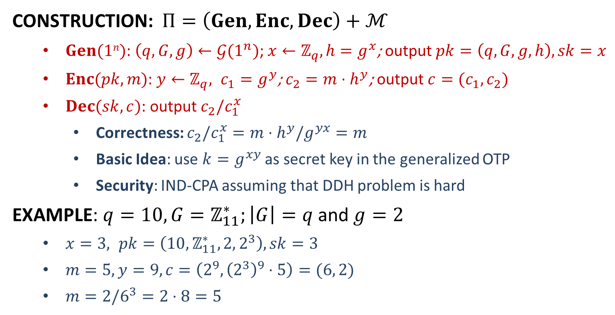
ElGamal Encryption
CONSTRUCTION: $Π=\left(Gen,Enc,Dec\right)+ℳ$
$Gen(1n)$: $\left(q,G,g\right)←𝒢(1^{n})$; $x←ℤ_{q}, h=g^{x}$; output $pk=\left(q,G,g,h\right), sk=x$
$Enc(pk, m)$: $y←ℤ_{q}, c_{1}=g^{y}$; $c_{2}=m⋅h^{y}$; output $c=(c_{1},c_{2})$
$Dec(sk, c)$: output $c_{2}/c_{1}^{x}$
Correctness: $c_{2}/c_{1}^{x}=m⋅h^{y}/g^{yx}=m$
Basic Idea: use $k=g^{xy}$ as secret key in the generalized OTP
Security: IND-CPA assuming that DDH problem is hard
EXAMPLE: $q=10, G=ℤ_{11}^{∗};\left|G\right|=q$ and $g=2$
$x=3, pk=\left(10,ℤ_{11}^{∗},2, 2^{3}\right), sk=3$
$m=5, y=9, c=\left(2^{9}, {\left(2^{3}\right)}^{9}⋅5\right)=(6, 2)$
$m=2/6^{3}=2⋅8=5$

Slide 25


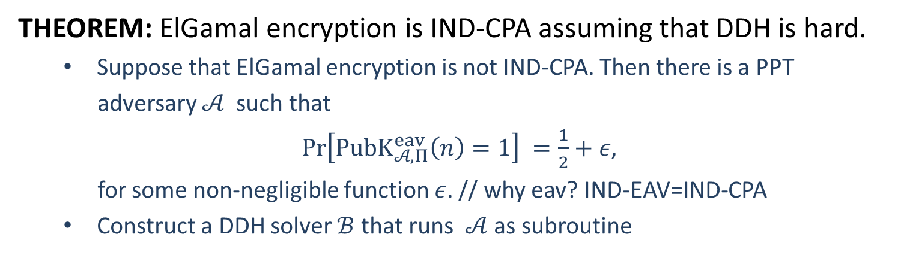





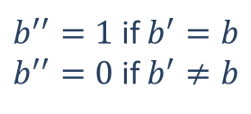

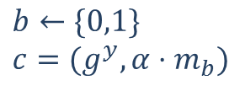

Security
THEOREM: ElGamal encryption is IND-CPA assuming that DDH is hard.
Suppose that ElGamal encryption is not IND-CPA. Then there is a PPT
adversary $𝒜$ such that
$\operatorname{Pr}\left[PubK_{𝒜, Π}^{eav}\left(n\right)=1\right] =\frac{1}{2}+ε$,
for some non-negligible function $ε$. // why eav? IND-EAV=IND-CPA
Construct a DDH solver $ℬ$ that runs $𝒜$ as subroutine
$$s=(q,G,g,g^{x},g^{y},α)$$
$α=g^{xy}$ or $α←G$
$$pk=(q,G,g,g^{x})$$
$$m_{0},m_{1}$$
$$b←\{0,1\}$$
$$c=(g^{y}, α⋅m_{b})$$
$$c$$
$$b′$$
$b^{′′}=1$ if $b^{′}=b$
$b^{′′}=0$ if $b^{′}≠b$
$$b^{′′}$$
$$ℬ$$
$$𝒜$$

Slide 26
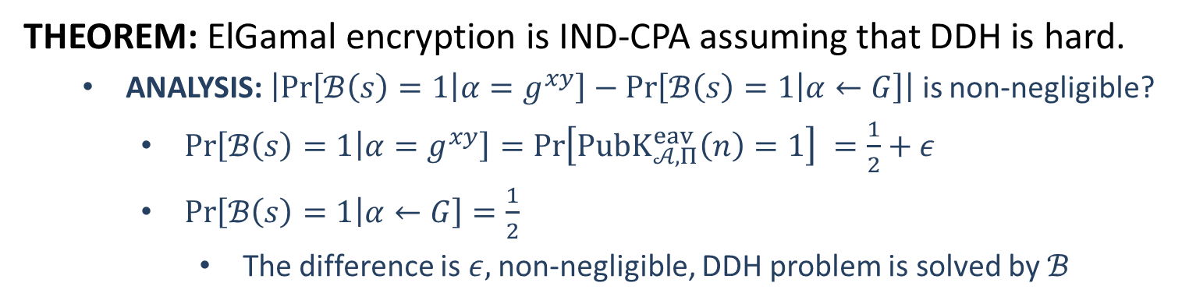
Security
THEOREM: ElGamal encryption is IND-CPA assuming that DDH is hard.
ANALYSIS: $\left|\operatorname{Pr}\left[ℬ\left(s\right)=1 | α=g^{xy}\right]−\operatorname{Pr}\left[ℬ\left(s\right)=1 | α←G\right]\right|$ is non-negligible?
$\operatorname{Pr}\left[ℬ\left(s\right)=1 | α=g^{xy}\right]=\operatorname{Pr}\left[PubK_{𝒜, Π}^{eav}\left(n\right)=1\right] =\frac{1}{2}+ε$
$\operatorname{Pr}\left[ℬ\left(s\right)=1 | α←G\right]=\frac{1}{2}$
The difference is $ε,$non-negligible, DDH problem is solved by $ℬ$
$$s=(q,G,g,g^{x},g^{y},α)$$
$α=g^{xy}$ or $α←G$
$$pk=(q,G,g,g^{x})$$
$$m_{0},m_{1}$$
$$b←\{0,1\}$$
$$c=(g^{y}, α⋅m_{b})$$
$$c$$
$$b′$$
$b^{′′}=1$ if $b^{′}=b$
$b^{′′}=0$ if $b^{′}≠b$
$$b^{′′}$$
$$ℬ$$
$$𝒜$$

